Slide 1

Unit 2: Introduction to KR
Computer Science Department
University of Verona - Italy

Slide 2
Attributive Logic with Complement
Unit 2 – Lecture 2.6

Slide 3
ALC LOGIC
Extension of AL In addition to AL, there are
Union Full existential quantifier Non-atomic negation

Slide 4
SEMANTICS OF ALC TERMINOLOGY
A terminology, as we have already said, is a set of axioms of inclusion and definition First of all, we will define the semantics of a PURE terminology, i.e. made up only of definitions

Slide 5
WHAT DOES A DEFINITION MEAN?
Given an interpretation that associates each letter with a set in the domain, a definition uses two types of elements
Primitive Concepts Defined concepts (i.e. concepts that correspond to a definition)

Slide 6
EXPANSION OF TERMINOLOGIES
A terminology T expands into a terminology T' when the same definitions of T appear in T', in which instead of some concepts defined in T there are expressions of the definitions of those concepts in T.

Slide 7
TERMINAL EXPANSION
A terminology T is said to be terminally expanded if every expansion of T is equal to T

Slide 8
BASIC INTERPRETATIONS
The function of interpreting basic terminology is to interpret only primitive concepts; An interpretation of all concepts of a terminology T extends the basic interpretation of the primitive concepts of T; A terminology T is said to be definitorial if and only if each basic interpretation is extended into one single interpretation of T.

Slide 9
FIXPOINT SEMANTICS (1)
In a terminology T , every name symbol A occurs exactly once as the left-hand side of an axiom A ≡ C.
Therefore, we can view T as a mapping that associates to a name symbol A the concept description T (A) = C.

Slide 10
FIXPOINT SEMANTICS (2)
With this notation, an interpretation I is a model of T if, and only if, A^{I} = (T (A))^{I}.
Let T be a terminology, and let J be a fixed base interpretation of T . By Ext_{J} we denote the set of all extensions of J.

Slide 11
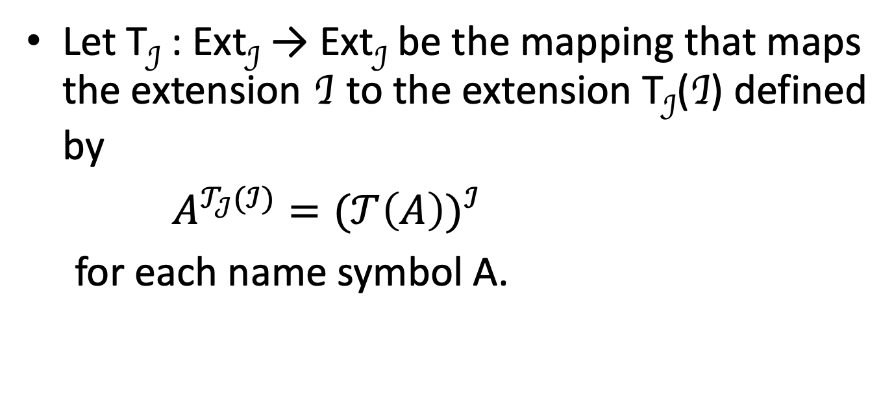
FIXPOINT SEMANTICS (3)
Let T_{J} : Ext_{J} → Ext_{J} be the mapping that maps the extension I to the extension T_{J}(I) defined by
$A^{𝒯_{𝒥}(ℐ)}{=(𝒯\left(A\right))}^{ℐ}$
for each name symbol A.

Slide 12
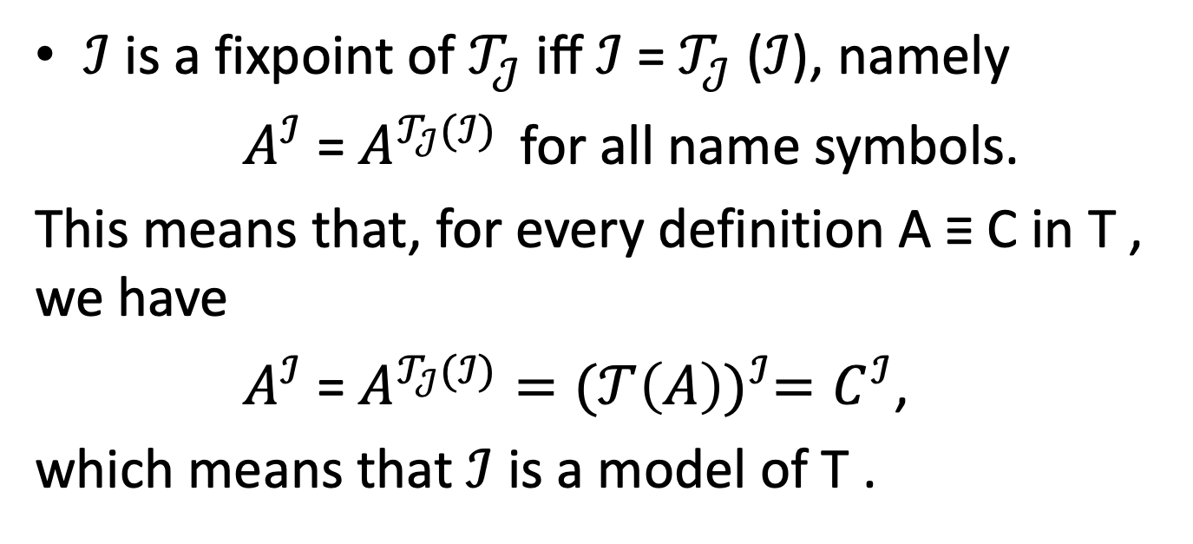
FIXPOINT SEMANTICS (4)
$ℐ$ is a fixpoint of $𝒯_{𝒥}$ iﬀ $ℐ$= $𝒯_{𝒥}$ ($ℐ$), namely
$A^{ℐ}$ = $A^{𝒯_{𝒥}(ℐ)}$ for all name symbols.
This means that, for every definition A ≡ C in T , we have
$A^{ℐ}$ = $A^{𝒯_{𝒥}(ℐ)}{=(𝒯\left(A\right))}^{ℐ}=C^{ℐ}$,
which means that $ℐ$ is a model of T .

Slide 13
GREATEST AND LEAST FIXPOINTS
A function f : L → L on a lattice (L, ≼) is monotone if f (x) ≼ f (y) whenever x ≼ y.
Tarski’s Fixpoint Theorem says that for a monotone function on a complete lattice the set of fixpoints is nonempty and forms itself a complete lattice. In particular, there is a least and a greatest fixpoint.

Slide 14
FIXPOINT SEMANTICS (CTD)
We define that a terminology T is monotone if the mapping T_{J} is monotone for all base interpretations J . By Tarski’s theorem, such terminologies have greatest and least fixpoints.

Slide 15
CONCEPTUAL DEPENDENCY GRAPH
Graph where:
Nodes are the concepts of a terminology; There is an arc between two concepts A and B when B appears in the definition of A.

Slide 16
EXAMPLE OF CDG DETERMINATION
+
A ≡ B ⊓ ∃R.¬C
B ≡ ∀R.E ⊔∃S.(D⊓E)
C ≡ ∃R.C
E ≡¬D
F ≡ ∃R.E
-
+
+
+
-
+

Slide 17
SYNTACTICALLY MONOTONIC TERMINOLOGIES (2)
A terminology T is syntactically monotonic if and only if one of the following conditions holds:
T is definitorial; T is negation-free; T cycles contain an even number of negations.

Slide 18
EXAMPLE OF ACYCLIC TERMINOLOGIES
EXPANSION 1
A ≡ B ⊓ ∃R.¬C
B ≡ ∀R.¬D ⊔∃S.(D⊓¬D)
E ≡¬D
F ≡ ∃R. ¬D
EXPANSION 2
A ≡ B ⊓ ∃R.¬C
B ≡ ∀R.¬D ⊔∃S.⊥
E ≡¬D
F ≡ ∃R. ¬D
EXPANSION 3
A ≡ ∀R.¬D ⊓ ∃R.¬C
B ≡ ∀R.¬D
E ≡¬D
F ≡ ∃R. ¬D
TERMINOLOGY
A ≡ B ⊓ ∃R.¬C
B ≡ ∀R.E ⊔∃S.(D⊓E)
E ≡¬D
F ≡ ∃R.E
EXPANSION 4
A ≡ ∀R.¬D ⊓ ∃R.¬C
B ≡ ∀R.¬D
E ≡¬D
F ≡ ∃R. ¬D

Slide 19
Examples

Slide 20
FIXPOINT SEMANTICS
Consider the following example:
Mos ≡ Man ⊓ ∀hasChild.Man The semantics for the above definition given easy: given the subset of the domain ∆ formed by ManJ and interpreted as a relation on ∆ hasChildJ the meaning of Mos is determined

Slide 21
MOMO
Momo ≡ Man ⊓ ∀hasChild.Momo
This definition is recursive and cannot be obtained like the semantics of Mos

Slide 22
EXAMPLE OF INTERPRETATION
Charles = {Charles₁, Charles₂, . . .}
James = {James₁, . . . , James_{Last}}
∆^{J} = Charles ∪ James
Man^{J} = ∆ ^{J}
hasChild^{J} = {(Charles_{i}, Charles_{(i+1)}) | i ≥ 1} ∪ {(James_{i}, James_{(i+1)}) | 1 ≤ i < Last}

Slide 23
EXAMPLE OF INTERPRETATION (ctd)
Mos^{J} = ∆^{J}
Momo^{J}1 = James
Momo^{J}2 = ∆^{J}
In fact, if only one Charles belongs to Momo, then everyone belongs to it.

Slide 24
MINIMAL FIXED POINT SEMANTICS
The least fixpoint semantics is the smallest fixed-point interpretation of a terminology For example, Momo's interpretation of only James is lfp

Slide 25
EXERCISE
Determine the semantics for a fixed-domain non-monotonic T terminology.

Slide 26
EXERCISE (ctd)
A ≡ B ⊓ ∃R.¬C
B ≡ ∀R.E ⊔∃S.(D⊓E)
C ≡ ∃R.C
E ≡¬D
F ≡ ∃R.E
BASIC INTERPRETATION
∆ = {a,b}
R = {(a,a),(b,b)}
S = {(a,b),(b,a)}
D = {a}

Slide 27
TABLE OF POSSIBLE SEMANTICS
 | A | B | C | E | F
1 | {b} | {b} | ∅ | {b} | {b}
2 | {b} | {b} | {a} | {b} | {b}
3 | ∅ | {b} | {b} | {b} | {b}
4 | ∅ | {b} | {a,b} | {b} | {b}

Slide 28
ANALOGOUS WITH MONOTONIC TERMINOLOGY
A ≡ B ⊓ ∃R.C
B ≡ ∀R.D ⊔∃S.D
C ≡ ∃S.C
 | A | B | C
1 | ∅ | {a,b} | ∅
2 | {b} | {a,b} | {a}
3 | {a} | {a,b} | {b}
4 | {a,b} | {a,b} | {a,b}

